Slide 1
This is a hidden slide
Dear honorable teacher please follow the instructions that has given in the slide notes (under the every slide). It would be helpful to take a successful class. Thanks a lot. I wish you good luck.

Slide 2

WELCOME
Notes:
Teacher can say it orally.

Slide 3


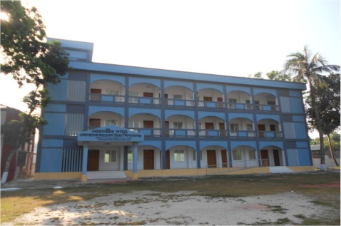
IDENTITY
SK. Md. Harunar Rashid
Senior Assist: Teacher
Sonatola Model High School, Sonatola, Bogra.
ENGLISH FOR TODAY
CLASS : SIX
UNIT - 5
Lesson : -
Notes:
Teacher can hide this slide.

Slide 4

Mind Set-up.
T: Do you know when do we say thank to any person ?
S: Sir, when any person acts, thinks and works good, we say -thank you.
Notes:
This slide is only for mind set up. Teacher can ask another questions to arrange the class. After that teacher can declare the lesson.

Slide 5
Today`s topic
Thanks for your work.
Notes:
Teacher can give thanks to class.

Slide 6
Learning outcomes
After completing this lessons tudents will be able to-
read and understand texts through silent reading.
infer meaning from context
Listen for information.
ask and answer questions
Write answers to questions and composition.

Slide 7
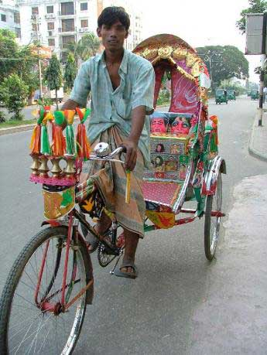
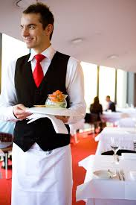
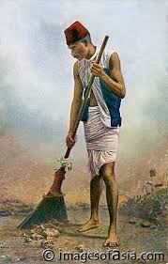
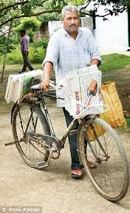
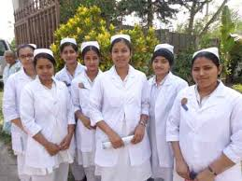
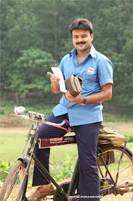
Open your book. Look and say. Use suitable words from the box to describe the occupation of each person below.
Newspaper hawker
Rickshaw-puller
waiter
nurse
cleaner
postman
Notes:
Teacher may give some time to elicit correct answer, then he/she will give the feedback.

Slide 8
Let’ watch a video clip
Click here
The man is cleaning our school.
What is the man doing?
Notes:
Showing the video teachers can ask question to the whole class. SS will raise their hands. Teacher can ask 5/6 students to narrate the video.

Slide 9
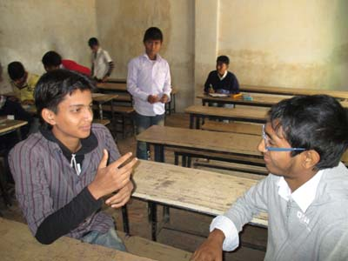
Go to the section – A1. Choose appropriate words from the box to complete the dialogue. Then act out the dialogue in pairs.
What does a rickshaw puller do?
What does a postman do?
A cleaner cleans our schools, houses, office and streets.
What does a waiter do?
A postman delivers letters and other items to us.
A hawker gives us newspapers every morning.
A rickshaw puller takes us from one place to another.
A waiter serves food at the restaurant.
What does a cleaner do?
What does a newspaper hawker do?
Notes:
After showing the conversation teachers will call 2/3 pairs for practice.

Slide 10
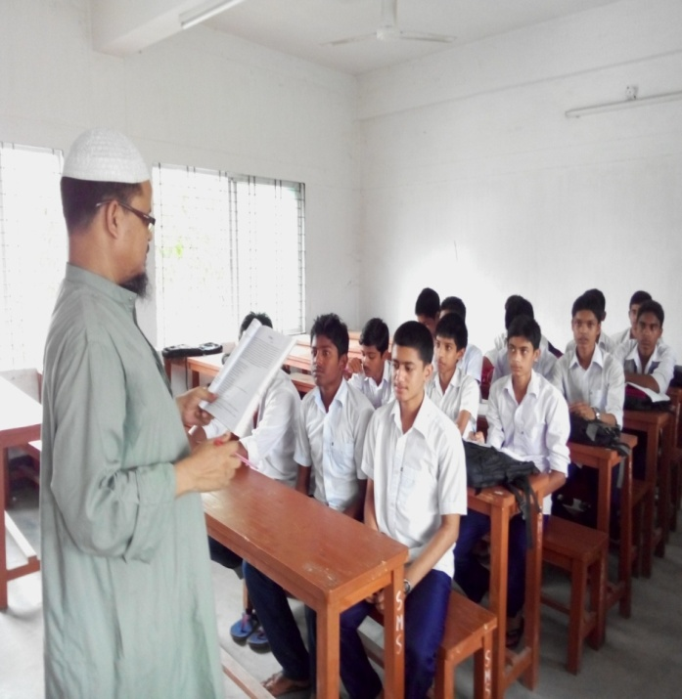
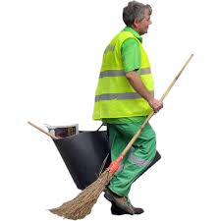
Close your book. Listen the text attentively then answer the following questions.
What time does Bulbul wake up?
Where do the people of Sankar put their rubbish?
Why does Bulbul think that all jobs are important?
Notes:
Teacher can elicit the answer by orally or written.

Slide 11

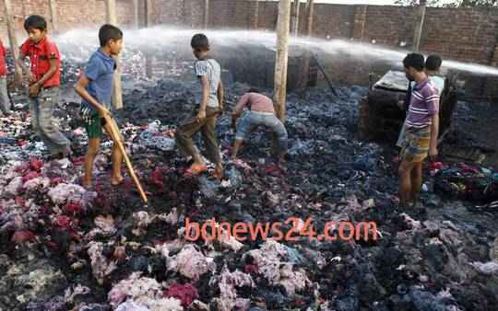
Collect
Key word
They are collecting waste material from the burn house.
Meaning
(Click here)
Gather / accumulate
Notes:
First, the word can be shown. The SS can be asked to pronounce the word. If it is needed, teacher can help. Then the picture can be shown and asked to guess the meaning. For feedback click on meaning button.

Slide 12
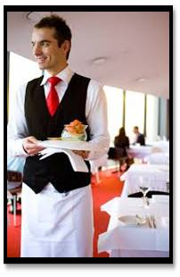
Waiter
Key word
The waiter is serving food at the restaurant.
Meaning
(Click here)
A man who serves food in the hotel.
Notes:
First, the word can be shown. The SS can be asked to pronounce the word. If it is needed teacher can help. Then the picture can be shown and asked to guess the meaning. For feedback click on meaning button.

Slide 13
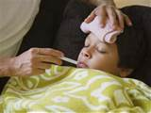
Sick
Key word
I am sick , so I could not go to school.
Meaning
(Click here)
ill / unwell
Notes:
First, the word can be shown. The SS can be asked to pronounce the word. If it is needed teacher can help. Then the picture can be shown and asked to guess the meaning. For feedback click on meaning button.

Slide 14
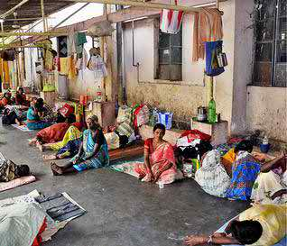
Unhygienic
Key word
The varenda of this hospital is unhygienic.
Meaning
(Click here)
Unhealthy / dirty
Notes:
First, the word can be shown. The SS can be asked to pronounce the word. If it is needed teacher can help. Then the picture can be shown and asked to guess the meaning. For feedback click on meaning button.

Slide 15
Grammar Focus
Simple Present Tense / Present Indefinite Tense
Structure : Sub + Present from of verb + obj / ext.
Bulbul + walks + from door to door.
He + takes out + everything from the bins.
We + respect + him very much.
In simple present tense, the verb takes an ‘s’ or ‘es’ if the subject is 3rd person singular number ( he. she, it, Rahim, Karim etc).
Notes:
Teachers can discuss about simple present tense.

Slide 16
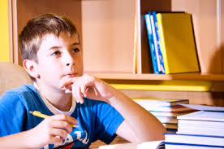
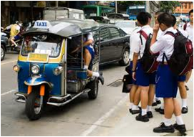
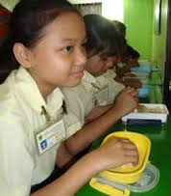
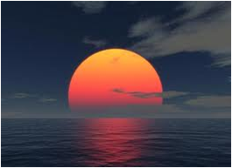

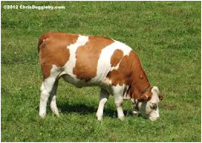
Individual Work
Now make five sentences in simple Present Tense about the following pictures. One is done for you :- I read in class six.
Notes:
Teacher can use board for evaluation.

Slide 17
Grammar Focus
Simple Past Tense :
Structure : Sub + Past from of verb + obj / ext.
Bulbul + was + sick for + two days.
He + came + to Sankar.
They + were + in great trouble.
In simple Past Tense, the verb is always in its past form (e.g. Got, Became, worked, etc).
Notes:
Teacher can discuss simple past tense.

Slide 18
Pair works.
Now go to the text and find out all the verbs. If the verbs is in the present tense then turn into them past tense.
One is done for you.
Present Tense | Past Tense
Wakes up | Woke up
Walks
Are
Does
Takes out
Notes:
Teacher can teach 20/25 strong and weak verbs.

Slide 19

HOME WORK
Think of a person who works in your area to help you live well. Write a composition on this person .
Notes:
Teachers can give some instructions to do home work.

Slide 20
Acknowledgement
We would like to express our cordial gratitude to the Ministry of Education, Directorate of Secondary & Higher Education, NCTB, a2i
and
the panel of honorable editors ( Md. Jahangir Hasan, Associate Professor (English) TTC, Rangpur, Ranjit Poddar, Associate Professor (English) TTC, Dhaka, and Urmila Ahmed, Associate Professor (English) TTC, Dhaka, to enrich the contents.

Slide 21
Notes:
Teacher can use another language.

